Slide 1
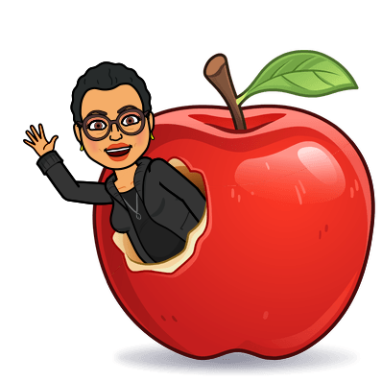
Welcome to Ms. Fairweather’s Class! G.E.A.R.S. Gifted Education & Academic Rigor Services! 2021-2022 Norview ES-Monday, Tuesday& Wednesday Tanners Creek ES-Thursday & Friday

Slide 2
About the teacher
My name is Fonda Fairweather and I have the distinct honor of working with your gifted child this year. This is my 32nd year teaching. I hold a Bachelor’s Degree from San Diego State University, a Master’s Degree in Reading from Grand Canyon University, an endorsement in Library Media from Old Dominion University, lifetime certification from University of California San Diego for Gifted and eight years’ experience as a Gifted/Seminar teacher with San Diego Unified School District.

Slide 3
What is my child’s identification and what does it mean?
Your child was identified using 5 criteria: CogAT test scores, teacher rating form, parent rating form, portfolio and interview.
Students who are identified gifted are identified in one of several ways: Reading, Math, Reading and Math, General Intellectual Aptitude (GIA).
If your child has any of those identifications, he/she will receive gifted services. Your child’s ID can not be taken away; it will stay with them as long as they are in Norfolk Public Schools.
Norfolk’s Local Plan for gifted education states that your child will be part of a cluster class and/or will receive services from the gifted teacher.
Pull out or push in model; cluster grouping; collaboration

Slide 4
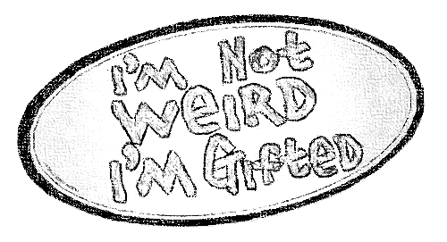
How will my child receive gifted services?
Currently I am pushing into grades 2-5 classes for instruction.
3 days at Norview ES(M,T & W); 2 days at Tanners Creek ES (TH,F)
We will be using Google Classroom https://classroom.google.com/c/MzQ1NDg4Mzg1OTY5 for asynchronous assignments. A notice on ClassDojo for joining my Google Classroom will go out tomorrow! ☺
Additional information is posted on the school website under the Our Families tab
Norview: Norview Elementary School / Homepage (npsk12.com)
Tanners Creek: Tanners Creek Elementary School / Homepage (npsk12.com)
Canvas is coming soon!

Slide 5
How will I know how
my child is doing in gifted?
I do not give grades; however, I do give a progress report or quarterly evaluation.
I collaborate with the classroom teacher about behavior and academics. Classroom grades are PRIORITY!
Communication with parents: Class Dojo for progress reports, notes and/or phone calls, as needed.

Slide 6
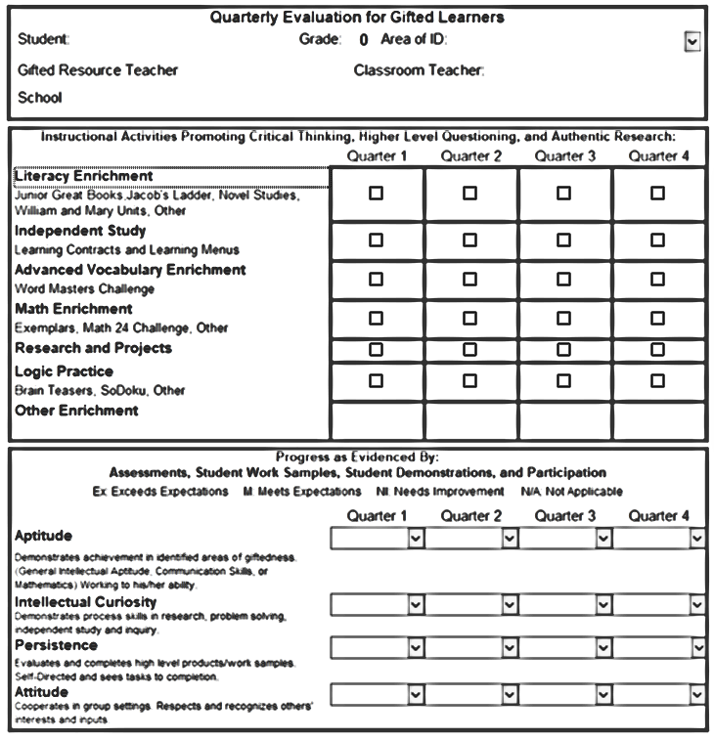
Quarterly Evaluations will be sent to you Class Dojo at report card time.

Slide 7
Testing When testing is going on, we will not have groups. I will notify you on Class Tag or Class Dojo. However, I will collaborate with teachers about assignments and there may be some asynchronous work on google classroom.
October: Gifted testing for last year’s VSA 1st graders
November: Gifted testing for referred students in grades 2-5
February: Gifted testing for all first-grade students
May/June: SOLs
Classroom testing (STAR, benchmarks, etc)

Slide 8
2nd and 3rd | 4th and 5th
Learning Style Inventory Junior Great Books Questioning strategies Exemplars (logic problems) | Learning Style Inventory Junior Great Books/Shared Inquiry Jacob’s Ladder Exemplars (logic problems)
Curriculum

Slide 10
Links to Learn More About our Curriculum
Junior Great Books: https://www.greatbooks.org/junior-great-books-k-5/
Jacob’s Ladder: https://education.wm.edu/centers/cfge/curriculum/languagearts/materials/jacobsladders/index.php
One Hour Mysteries: https://www.rainbowresource.com/category/3481/One-Hour-Mysteries.html
Logic Safari: https://www.routledge.com/Logic-Safari-Book-1-Grades-2-3/Risby/p/book/9781593630898
Exemplars: https://exemplars.com/
Noetic Math: https://www.noetic-learning.com/

Slide 11
E-mail is the easiest way to reach me:
ffairwe@nps.k12.va.us

Slide 12
Questions?????

